Slide 1

Deloitte Lean Six Sigma Method.
Lean Six Sigma Training
Day 4 – Future State 2, Work Pilot

Slide 2

Agenda Day 4 – Future State 2 & Work Pilot
Section 1 | Teach Back – Days 1, 2, and 3 Introduction to Future State 2
Section 2 | Action Brainstorm Work Breakdown Structure Work Packages Exercise - Implementing the Future State Design
Section 3 | Introduction to Work Pilot Set Up & Run a Work Pilot
Section 4 | Run Final Simulation Record and review simulation performance
Section 5 | Lean management tools and techniques Planning the Transfer to BAU
Section 6 | Course Review & Wrap up Overall WWW and WBBI

Slide 3


Teachback So tell us what you know so far about LSS....
15 minutes
In the style of...
?

Slide 4
The Deloitte 5 Workshop Approach Where does today fit in the 5 Workshop approach?
M - Mobilisation Workshop
CS1 - As-Is High level Workshop
CS2 - As-Is Detail Workshop
FS1 - Future State Workshop
FS2 - Implementation Planning Workshop
WP - Running the
Work Pilot
Outputs
Project Kick-off
Finalised Scope
High-level process
Team Selected
High level plan agreed
Customer requirements
Plan interviews and current state mapping
Current State map
Report back to key stakeholders
Future State map
Report back to key stakeholders
Implementation plan & charters
Final Report back
Rapid execution of the quick hits and impro-vement opportunities identified
Confirm expected benefits
Initial identification of the “just do it” to be refined and designed, ready to be executed
Key Activities
Lean Awareness
Validation of end to end process scope
Value tree analysis
Refine charter
Confirm data requirements
Identify design boundaries
Lean education by “doing” in a practical environment - team building
Review charter, SIPOC and demand
Understand who the customers are (VOC) and their requirements
Value Stream Flow
Plan for ‘seeing is believing’
Seeing is Believing - Walk the process to understand what really happens, how long it takes, and what the key issues are
Construct the current end to end value stream map
Conduct value and waste analysis; identify what is preventing the value to flow
Define blue sky vision and agree future state lean design principles
Map the future state
Highlight benefits
Identify the implementation work packages and draft charters
Prioritise work packages
Define a high-level implementation plan
Agree pilot content
Agree governance and gain stakeholder buy-in
Test & refine the new streamlined process in a safe environment
Implement visual management
Develop standardised operating procedures
Measure new KPIs
Up-date the front line knowledge base,
Plan transfer to BAU
Tools and techniques
Problem scoping
Identify process owners, suppliers, customers (SIPOC)
Value Tree
Data collection
Project Charter
Lean simulation game
VOC data & CTQ
Understand demand - Mississippi Chart
Runners, Repeaters and Strangers
Value tree
Seeing is Believing
Value stream mapping
Baseline Metrics
7 wastes analysis
Root cause analysis and problem-solving
5S analysis (work place management)
Lean design principles
Pull systems and one piece flow
Mistake proofing
Andon system
Takt time
Cycle time diagram
Load balancing
Improvement Work Packages charters
Ease versus Impact assessment
Gantt chart
Work pilot mission
5S environment
Standard Work
Decision Trees
Skill matrix
KPI & Run charts
Control charts
Quality matrix, FMEA
Problem solving & 8D
Notes:
Version

Slide 5
Future State 2 What are the main objectives of the first Future State workshop?
Mobilisation
Current State
Future State
Implement improvements
Week -2
M | T |  | T | F
Week 1
M | T | W | T | F
Week 2
M | T | W | T | F
Week 3
M | T | W | T | F
Week 4
M | T | W | T | F
Week 5 12
M | T |  | T | F
M
CS1
CS2 – Map
FS1
FS2
Work pilot
M
Mobilisation: Kick-off, confirm scope, SIPOC, team – complete project charter
½ day
CS1
Current State 1: Lean Simulation, VoC, value stream flow,
plan for ‘seeing is believing’
1 day
CS2
Current State 2: Seeing is believing, as-is value stream map
3 days
FS1
Future State 1: Value and waste analysis, blue sky vision, to-be value stream map
2 days
FS2
Future State 2: Work package definition and charters, prioritisation
and high level plan
2 days
WP
Work Pilot: Test the changes and refine the design before roll-out
8 weeks

Slide 6
Agenda Day 4 – Future State 2 & Work Pilot
Section 1 | Teach Back – Days 1, 2, and 3 Introduction to Future State 2
Section 2 | Action Brainstorm Work Breakdown Structure Work Packages Exercise - Implementing the Future State Design
Section 3 | Introduction to Work Pilot Set Up & Run a Work Pilot
Section 4 | Run Final Simulation Record and review simulation performance
Section 5 | Lean management tools and techniques Planning the Transfer to BAU
Section 6 | Course Review & Wrap up Overall WWW and WBBI

Slide 7

Action Brainstorm Note down all the ideas
Implement 5S filing - contracts
Develop skills matrix – input team
Inputs to one screen
Actions required to implement the future state
Over processing – order entry is input into two separate screens
Install printer for invoice preparer
Mistake proof order entry
To get to an implemented future state value stream a series of changes are required
Brainstorm all the actions that need to occur to go from the current state to the future state on post-its
Hot Tips
Use verbs, not nouns, to describe the actions that need to be taken
Don’t forget about the enablers that are documented on the future state map
Refer back to the wastes when considering the actions and check that they have been addressed

Slide 8

Work Breakdown Structure The breakdown of complex task into work packages
An affinity diagram involves the grouping of qualitative* information into major categories
An affinity diagram can be an effective tool to organise the actions that have been developed into work size packages
The resulting groups define each work package to implement
A
A
C
A
B
C
A
C
B
B
B
A
C
C
Hot Tips
If the work package grouping becomes too large or there is a mix of implementation complexity, break into further sub groups categories so that work packages become smaller and more manageable
Start with 3 major categories of “quick win”, “short term” and “medium term” to highlight which actions can be completed quickly
*Qualitative: an opinion / view / perception

Slide 9
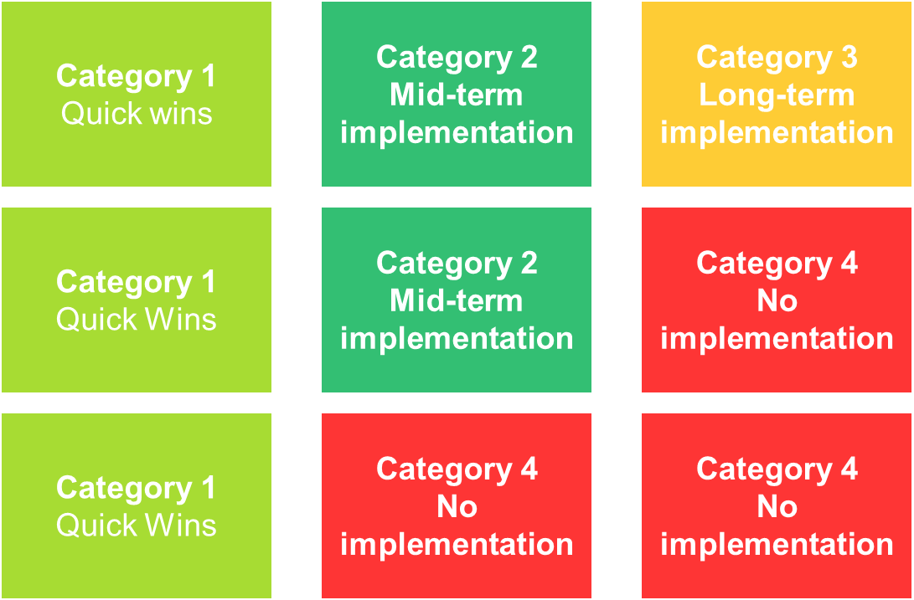
Work Packages - Prioritisation What do to first
Objective: Prioritise the implementation
Implementing high impact, easy solutions first will maintain sponsor engagement
Key questions:
How easy is it to implement the work package?
How much time is needed?
Is IT development required?
Will it cost a lot of money?
How much will operation of the process change?
Improve multiple customer requirements e.g. time, defects
Substantial improvement of THE one big customer requirement
The ranking should be relative against each work package
If any work packages need to dropped, then the future state value stream should be checked for impact
High
Package – Layout
Package – 5S
Expected benefits
Rankings are relative – 5S is easier to implement that IT, but has less impact
Package – IT
Low
Easy
Ease of Implementation
Hard

Slide 10
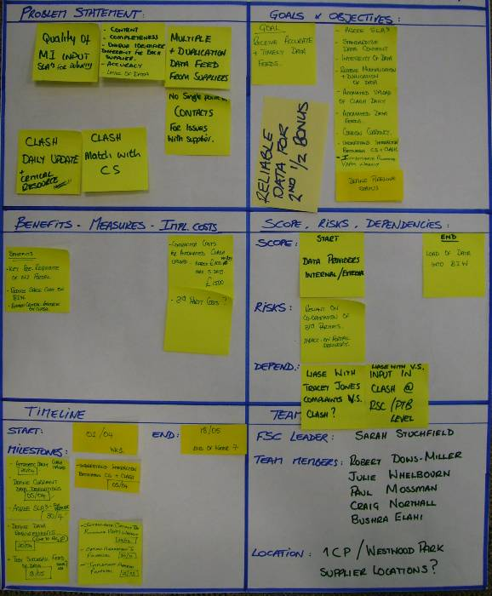
Work Packages - Charter Development Each work package will become a mini-project on his own
Objective: Frame each work package with a charter
Key questions:
What is the scope of this package?
What are the key deliverables?
What are the expected delivery dates?
Who will take the ownership?
Team work:
Take the list of actions with each work package and align them into a charter
Identify the teams, stakeholder and the milestones
Ensure the scope is clear to avoid duplication of actions or efforts between work packages
A work package should be defined and developed for KPI implementation (incl.VoC) and the set up of the work pilot (incl. setting the logistics)
Work Package Charter

Slide 11
Work Packages - High Level Plan A view of all work packages
Objective: Establish the implementation plan, focusing on key milestones
Team work:
Each work package will form a line item in the work plan and have a lead assigned
The list of actions that have been sorted into completion order will make it easier to identify timing on the Gantt chart
Look to track significant and visible achievements, actions that have dependencies, or critical actions that can cause delay to implementation
Use a dot and line to indicate start dates of the work packages
Look for bunching of actions as this may indicate overload on resources
Check the logic of actions to be completed before others and dependent work packages
Milestones (pink Post-Its) are linked with tangible deliverables resulting from the execution of the work packages
Hot Tips

Slide 12
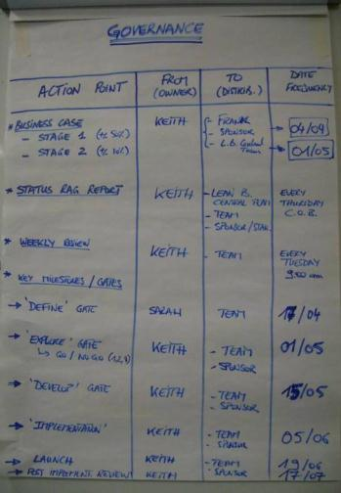

Work Packages - Governance Vital implementation information
Objective: Establish the governance arrangements for the implementation phase
The Governance arrangements will allow the team to decide how they will interact during the implementation and report progress to the Sponsor
Team work:
The team will need to review actions weekly to keep a focus on progress
The work pilot team will need to report back performance results based on defined KPI
A risk/progress update will need to be made to the Sponsor
Agree to meet regularly in the pilot area with the Sponsor to review progress
Agreeing to meet a day every week will ensure that time is assigned to implement the improvements
Hot Tips

Slide 13
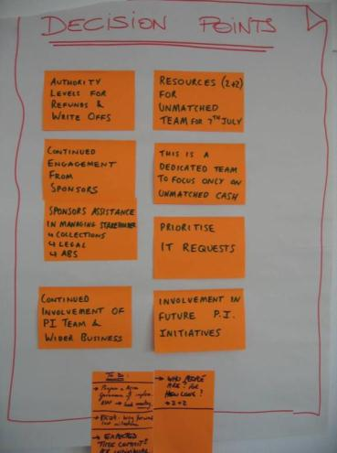

Work Packages - Decision points Key stopping points
Objective: Establish the governance arrangements for the implementation phase
Team work:
Prior to the final Report Back to the sponsor and stakeholders key decisions should be listed to get approval
Seek to gain approval for:
Resources, including people for the pilots
Frequency of governance reporting and work pilot reviews
Any budget amounts that are required e.g. relocation of offices, purchases of material, white boards for visual management…
Hot Tips
Before the Report Back it is advisable to give a heads up to the Sponsor of what type of decisions will be expected !

Slide 14


Exercise Implementing the Future State Design
Back in your simulation groups, take all that you have worked on over the past day...
Identify your implementation work packages
Prioritise your work packages in terms of Ease to Implement vs Impact
Draft a charter for one of your work packages
Define a high-level implementation plan, agree governance and get stakeholder buy-in from your facilitator
And then go and implement your Future State Design
30 minutes

Slide 15
Agenda Day 4 – Future State 2 & Work Pilot
Section 1 | Teach Back – Days 1, 2, and 3 Introduction to Future State 2
Section 2 | Action Brainstorm Work Breakdown Structure Work Packages Exercise - Implementing the Future State Design
Section 3 | Introduction to Work Pilot Set Up & Run a Work Pilot
Section 4 | Run Final Simulation Record and review simulation performance
Section 5 | Lean management tools and techniques Planning the Transfer to BAU
Section 6 | Course Review & Wrap up Overall WWW and WBBI

Slide 16
Work Pilot The final stages
Mobilisation
Current State
Future State
Implementation
Week -2
M | T |  | T | F
Week 1
M | T | W | T | F
Week 2
M | T | W | T | F
Week 3
M | T | W | T | F
Week 4
M | T | W | T | F
Week 5 12
M | T |  | T | F
M
CS1
CS2 – Map
FS1
FS2
Work pilot
M
Mobilisation: Kick-off, confirm scope, SIPOC, team – complete project charter
½ day
CS1
Current State 1: Lean Simulation, VoC, value stream flow,
plan for ‘seeing is believing’
1 day
CS2
Current State 2: Seeing is believing, as-is value stream map
3 days
FS1
Future State 1: Value and waste analysis, blue sky vision, to-be value stream map
2 days
FS2
Future State 2: Work package definition and charters, prioritisation
and high level plan
2 days
WP
Work Pilot: Test the changes and refine the design before roll-out
8 weeks

Slide 17
The Deloitte 5 Workshop Approach Where does today fit in the 5 Workshop approach?
M - Mobilisation Workshop
CS1 - As-Is High level Workshop
CS2 - As-Is Detail Workshop
FS1 - Future State Workshop
FS2 - Implementation Planning Workshop
WP - Running the
Work Pilot
Outputs
Project Kick-off
Finalised Scope
High-level process
Team Selected
High level plan agreed
Customer requirements
Plan interviews and current state mapping
Current State map
Report back to key stakeholders
Future State map
Report back to key stakeholders
Implementation plan & charters
Final Report back
Rapid execution of the quick hits and impro-vement opportunities identified
Confirm expected benefits
Initial identification of the “just do it” to be refined and designed, ready to be executed
Key Activities
Lean Awareness
Validation of end to end process scope
Value tree analysis
Refine charter
Confirm data requirements
Identify design boundaries
Lean education by “doing” in a practical environment - team building
Review charter, SIPOC and demand
Understand who the customers are (VOC) and their requirements
Value Stream Flow
Plan for ‘seeing is believing’
Seeing is Believing - Walk the process to understand what really happens, how long it takes, and what the key issues are
Construct the current end to end value stream map
Conduct value and waste analysis; identify what is preventing the value to flow
Define blue sky vision and agree future state lean design principles
Map the future state
Highlight benefits
Identify the implementation work packages and draft charters
Prioritise work packages
Define a high-level implementation plan
Agree pilot content
Agree governance and gain stakeholder buy-in
Test & refine the new streamlined process in a safe environment
Implement visual management
Develop standardised operating procedures
Measure new KPIs
Up-date the front line knowledge base,
Plan transfer to BAU
Tools and techniques
Problem scoping
Identify process owners, suppliers, customers (SIPOC)
Value Tree
Data collection
Project Charter
Lean simulation game
VOC data & CTQ
Understand demand - Mississippi Chart
Runners, Repeaters and Strangers
Value tree
Seeing is Believing
Value stream mapping
Baseline Metrics
7 wastes analysis
Root cause analysis and problem-solving
5S analysis (work place management)
Lean design principles
Pull systems and one piece flow
Mistake proofing
Andon system
Takt time
Cycle time diagram
Load balancing
Improvement Work Packages charters
Ease versus Impact assessment
Gantt chart
Work pilot mission
5S environment
Standard Work
Decision Trees
Skill matrix
KPI & Run charts
Control charts
Quality matrix, FMEA
Problem solving & 8D
Notes:
Version

Slide 18

Work Pilot definition What happens in this stage
A work pilot serves as a tentative model for future deployment
Work Pilots are generally conducted for a pre-determined period to simulate a newly improved and streamlined process (or part of it) prior to a large scale deployment.
The effort is then evaluated and refined before moving into full implementation
A work pilot is a test of a proposed solution
This type of test has the following characteristics:
Used to evaluate both the solution and the implementation of the solution
Perform on a small scale
Purpose is to make the full scale implementation more effective
Gives data about expected results and exposes issues in the implementation plan

Slide 19
Why use a Work Pilot The uses
Why do I use a Work Pilot?
Allows testing of assumptions, new configurations-of-work, and procedures of new processes/ systems
Allows fine tuning of the design(s) of solutions
Confirms the full-scale expected benefits
Minimises the problems and surprises of implementation and correct them before a full-scale rollout
Helps people become comfortable and familiar with the new process/system
Showcases to stakeholders and employees what the new process will look & feel like
Demonstrate real commitment from the management team to change and improve the ways of working
Pilots are particularly useful when it is not clear:
How the overall rollout of the solutions will occur in all depar-tments impacted
What risks are being taken
How the environment might respond to the change
How the company’s culture will affect the deployment

Slide 20
Work Pilot objectives What we are planning to achieve
Work Pilot objectives
Test & refine the new streamlined process in a safe environment
Experiment and develop new effective ways of working
Identify key skills to perform the new process
Train and up-skill core team of “front line doers” to operate the new process
Develop, test and refine standardised operating procedures
Measure and action new KPIs
Confirm the expected benefits
Three key deliverables
Validated new streamlined end to end process
Validated Business Case with revised expected benefits
Plan to transfer the new process into Business As Usual
Tools & Techniques
Work pilot mission
Ways of working
5S environment
Standard Work
Decision Trees
Skill matrix
KPI & Metrics
SPC, Control charts
Quality matrix, FMEA
Root cause analysis
Problem solving

Slide 21
The set up starts at the mobilisation phase The timeline of preparing for the work pilot
Mobilisation
Current State
Future State
Implementation
Week -2
M | T |  | T | F
Week 1
M | T | W | T | F
Week 2
M | T | W | T | F
Week 3
M | T | W | T | F
Week 4
M | T | W | T | F
Week 5 12
M | T |  | T | F
M
CS1
CS2 – Map
FS1
FS2
Work pilot
Highlight the needs to run a Work Pilot and engage with the
Sponsor to free up resources
1
Kick off
Work Pilot
5
Anticipate what quick wins could be tested during the Work Pilot
Plan the logistics of the set up
Starting the Work Pilot the week following the last work-shop is critical:
You will benefit from the momentum built up with the team
2
Scope which part of the realistic future state process could be tested in the Work Pilot
Identify the key resources needed to run the Work Pilot and define the roles & responsibilities
Organise the logistics of the Work Pilot
3
Confirm resources, location and initial set-up of the Work Pilot
Prepare kick off workshop with initial Work Pilot team
4
21

Slide 22

Logistics of setting up a Work Pilot Things that need to be considered
Team and resources
Identify team leader(s) and team members (how many, from which department and who)
Agree availability and duration
Job roles & responsibilities
Simple team structure
Logistics and location
Location, desks & chairs, PC, software licences,
Flip charts, visual boards & posters…
Unit(s), physical location(s)
Performance management
Clear goal and outcomes
Key Performance Indicators with agreed targets
Defined process & products
Realistic future state process
Agree customer demand by products used in the pilot (e.g. real cases)

Slide 23
3 Levers to initiate a Continuous Improvement culture
The Right Projects
Leadership & alignment
Leadership engagement
Strategic Alignment
Governance
Resourcing
The Right Approach
Operational delivery
Process management
Measurement & Benefits
Customer Voice
Methods and Tools
The Right People
People and behaviours
Roles & Responsibilities
Performance Alignment
Capability and Learning
Communication

Slide 24
Success factors to run the work pilot Using the 3 Levers model to set up the work pilot
Operational delivery
Leadership & alignment
People and behaviours
Leadership Engagement
End to end management
Regular management reviews at the new work place
Roles & Responsibilities
Shared and agreed Future State Process
Definition of new Roles & Resp. aligned with the new process
Performance measures
Work Pilot
Capability & Learning
Clear and defined KPI on which the team can act
Development of Skills Matrix and cross-training
Methods and tools
Mindset & behaviors
Lean Work Place,
Visual Management,
and Problem Solving
New ways of working introduced with Daily Management routine
Governance
Escalation process for problem solving and progress reporting
“Customer Voice” will be covered within “Measurement”
Full time “Resourcing” provided with a dedicated Work Pilot team

Slide 25


Simulation Pilot Round Implement your future state design and run the final round
Run Simulation Pilots
20 minutes

Slide 26
Agenda Day 4 – Future State 2 & Work Pilot
Section 1 | Teach Back – Days 1, 2, and 3 Introduction to Future State 2
Section 2 | Action Brainstorm Work Breakdown Structure Work Packages Exercise - Implementing the Future State Design
Section 3 | Introduction to Work Pilot Set Up & Run a Work Pilot
Section 4 | Run Final Simulation Record and review simulation performance
Section 5 | Lean management tools and techniques Planning the Transfer to BAU
Section 6 | Course Review & Wrap up Overall WWW and WBBI

Slide 27
Simulation Final Round Implement your future state design and run the final round
Run Simulation Round 3
30 minutes

Slide 28

Simulation Final Round Feedback and final round summary
Feedback - How did it go?
End to End (E2E) process
WIP levels
Idle time
Morale during the process

Slide 29
Agenda Day 4 – Future State 2 & Work Pilot
Section 1 | Teach Back – Days 1, 2, and 3 Introduction to Future State 2
Section 2 | Action Brainstorm Work Breakdown Structure Work Packages Exercise - Implementing the Future State Design
Section 3 | Introduction to Work Pilot Set Up & Run a Work Pilot
Section 4 | Run Final Simulation Record and review simulation performance
Section 5 | Lean management tools and techniques Planning the Transfer to BAU
Section 6 | Course Review & Wrap up Overall WWW and WBBI

Slide 30
Lean management tools & techniques
Standard work
Voice of the Customer
Visual management
SIPOC
Problem solving
Identify value and the value stream
Go and See
Sustain and CI
5 S
Value Stream Mapping
Establish Flow & Pull
Mistake proofing
Pull systems
Cellular flow
Andon
Continuous flow
Takt time

Slide 31
Lean management tools & techniques
Quality rule
Do not accept a defect
Do not produce a defect
Do not pass on a defect
Visibility rule
See as a team
Know as a team
Act as a team
Standardization rule
There are no problems if there are no standard
Having standards ≠ Standard work
Illustration du Lean Manager https://www.youtube.com/watch?v=rsUkS2hQ4DA&app=desktop

Slide 32
Lean management tools & techniques 5S environment - Application of 5S in Office environments
Seiri | Sorting | Determine necessary and unnecessary. Remove unnecessary
Seiton | Straighten | Keep needed items in one place to allow easy retrieval at the point of use
Seiso | Shine | Sweep and clean the work area
Seiketsu | Standardize | Hold the gains of the first three while preparing for the next improvement
Shitsuke | Sustain | Make a habit of maintaining established procedures
Anzen | Safety | Identify dangerous and hazardous conditions
Higher Quality
Product Diversification
Seiri
Seiton
Separate needed items from unneeded and eliminate the latter
Keep items in the correct place to allow easy retrieval
Higher Availability Rate
Lower Costs
Shitsuke
Habit of maintaining established procedures
Improved Safety
Maintain the first three
Keep area swept and clean
Reliable Deliveries
Sieketsu
Sieso
Anzen

Slide 33

Exercise
5S Game
20 minutes
Let’s test what a difference 5S can make
Notes:
Worksheets 1 – 4 people circle numbers 1 to 49 in numerical order. In each round give 30s to 1min. See how far people have got after each round. Check after each round how people found it.
Worksheet 1: Baseline
Worksheet 2: SORT - Unnecessary numbers outside 1 – 49 removed
Worksheet 3: SIMPLIFY – start in bottom left the one number in each grid
Worksheet 4: SHINE, STANDARDISED – tidied up numbers so they are in order
Worksheets 5 and 6 you have to identify the missing numbers
Worksheet 5 – difficult, has not been SUSTAINED
Worksheet 6 – very easy.
On worksheets 5 and 6 you have to identify the numbers that are missing.

Slide 34
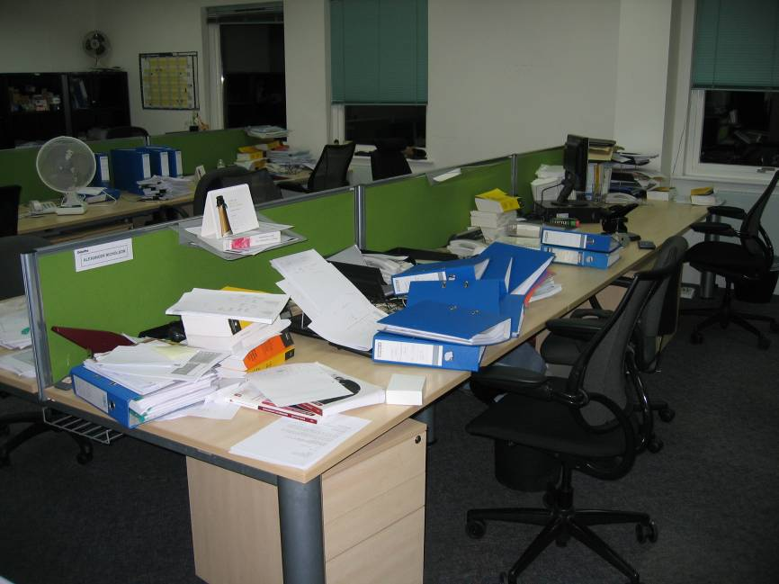
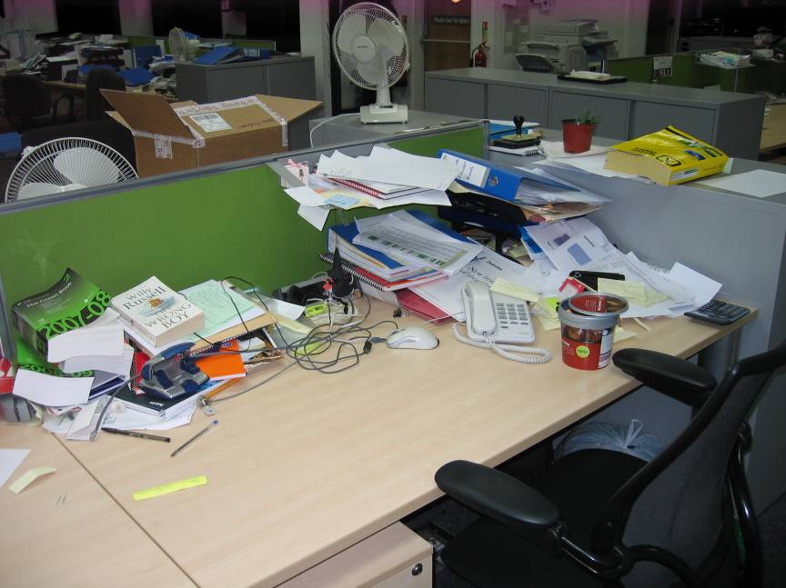
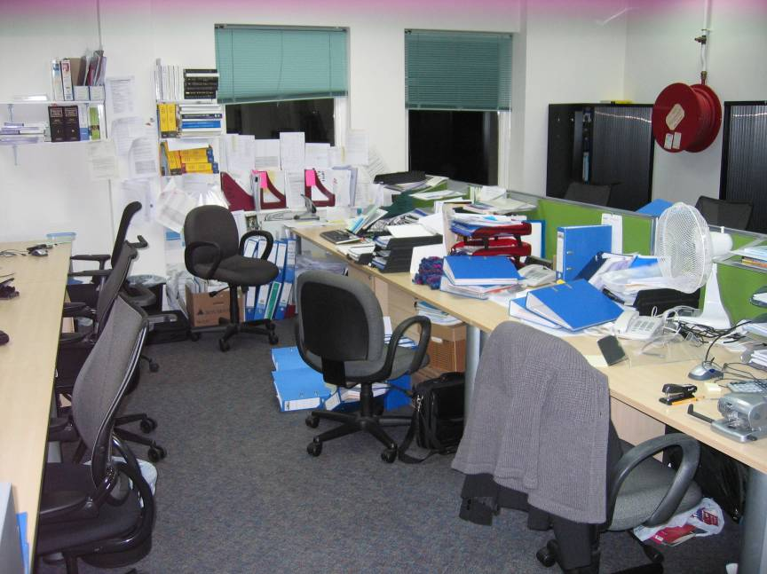
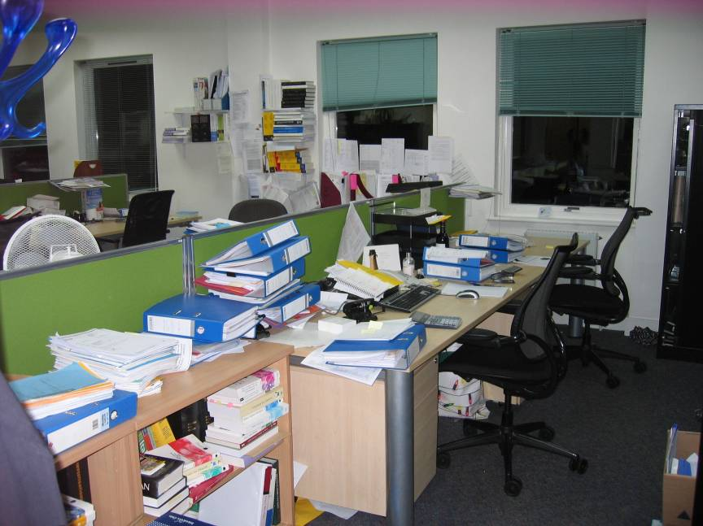
If you don’t believe me…

Slide 35
Lean management tools & techniques 5S environment - Application of 5S in Office environments
Applying 5S can result in:
Less
Downtime
Errors and Waste
Inventory
Searching
Storing
Waiting
Walking
Wandering
Wondering
Improve
Improve
Cleanliness
Employee Morale
Floor Space
Workspace Organization (remove clutter)

Slide 36
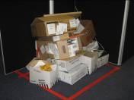
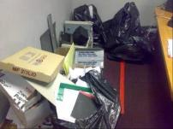


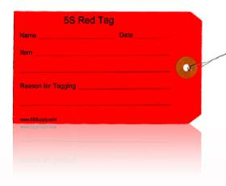
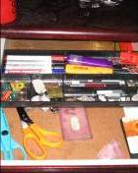
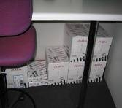

Lean management tools & techniques 5S environment - Application of 5S in Office environments
Assessing the Current State: 5S (Sort) begins with the Red Tagging of all items which are unnecessary.
These items are place within a quarantine area, and if they haven’t been used all week, they are thrown away.

Slide 37
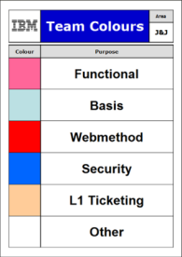
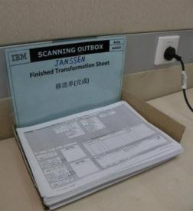
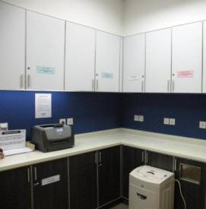
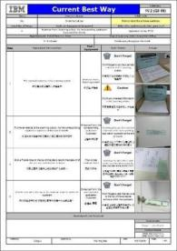
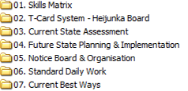
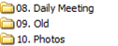
Lean management tools & techniques 5S environment - Application of 5S in IT Helpdesk Operations
Implementing the Future State: 5S (Set In Order) assigns a colour of each Application Team, defines a method to capture physical evidence and coloured signage informs team members were to store achieved documents. This method is agreed and documented in a Current Best Way (Sustainment).
The same organisation principles also applies to Team Rooms or folder structure on a consultants PC. Periodic clean up (Shine) of Team Rooms is essential and alerts team members of new material.

Slide 38
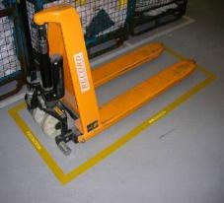
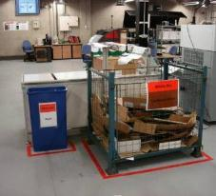
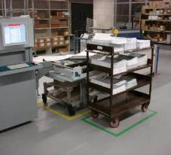
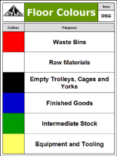
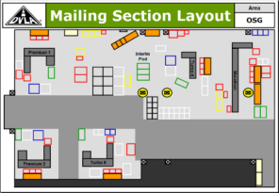
Lean management tools & techniques 5S environment - Application of 5S in Shopfloor environments
Implementing the Future State: 5S (Set In Order) promotes zoned, painted floors, with specific areas for specific functions throughout the whole facility (Standardisation).
Areas are kept clean and clear throughout the day (Shine), with sustainment at end of day / shift – Preventing items getting lost and reordered.
Everything returned to its “home” upon use (Sustain) and everything required is nearby – Results in reduced process time

Slide 39
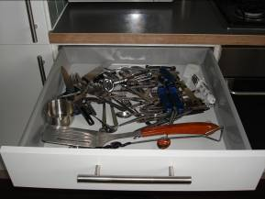
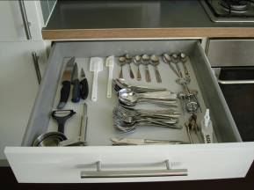
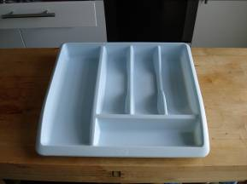
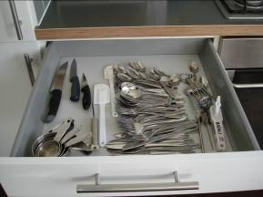
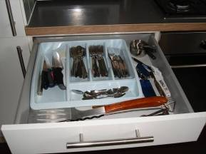
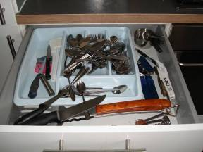
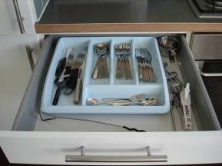
Lean management tools & techniques 5S environment - Everyday application in the Kitchen
Current State
1. Sort
2. Set in Order
3. Shine (Clean and Inspect)
4. Standardise – Example of not educating others in the standard
5. Sustain
Notes:
The audience my not think it, but they undertake 5S activities every day at home without realising.
Sort – Sorting knifes and forks
Set in order – Organise and use tray – A place for everything, and everything in its place!
Shine – Clean the knifes and forks and put in order
Standardise – Define standard layout of tray
Sustain – Adhere to try standard. Sustainment presents opportunities for further improvements, such as reduction of cluttered cutlery and ability to visualise the keep control of the situation. For example, Tea spoons inevitability get lost – reorder quantity.
Sustainment is the most difficult step. If we cannot sustain, the work conducted and time taken during the first four steps is essentially waste – as you’ve resorted back to the old current state you moved away from!
SHOW MICHAEL MCINTYRE MAN DRAWER

Slide 40

Lean management tools & techniques 5S: Sort → Straighten → Shine → Standarise → Sustain
Notes:
How does a good 5S looks like?
Would u like to be the man in the picture?

Slide 41
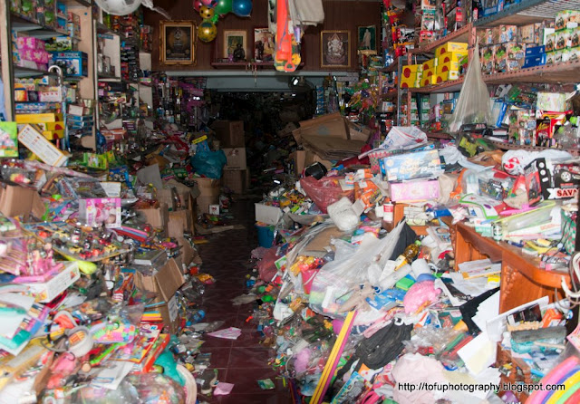
Tools & Techniques
Notes:
Imagine u are the shop owner.
How do you feel. Describe.
Can you find what you need easily? Why?
Is this a safe environment?

Slide 42
Lean management tools & techniques One of the foundation of 5S is Visual management
Seeing as a Group
Production Status
Inventory Levels
Equipment Availability
Knowing as a Group
Acting as a Group
Delivery Commitments
Goals And Schedules
Consensus on Objectives, Plans and Targets
Involvement in Improvement Activities

Slide 43

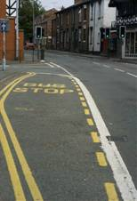


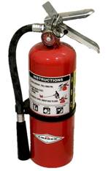


Lean management tools & techniques Visual management is here everyday
We see and use visual management every day
When processing and delivering orders we see:
SAP error messages (that need our attention)
Control reports (highlighting activities not completed)
Vehicle Signs/Lights (assisting haulier drivers with loading)
Smart suppliers/employees set up and amend templates (that identify where data has not been entered)
Visual identification signs in warehouses (to locate product inventory)
We are surrounded by Visual Management, but we rarely bring it to work with us…

Slide 44
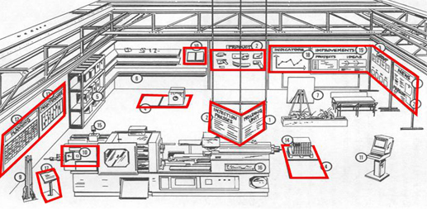
Lean management tools & techniques Simple visual aids can be used throughout the workplace
Visual management can be used in many different ways
What examples can you think of from your other clients?

Slide 45
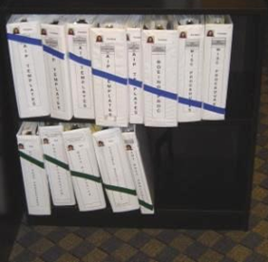
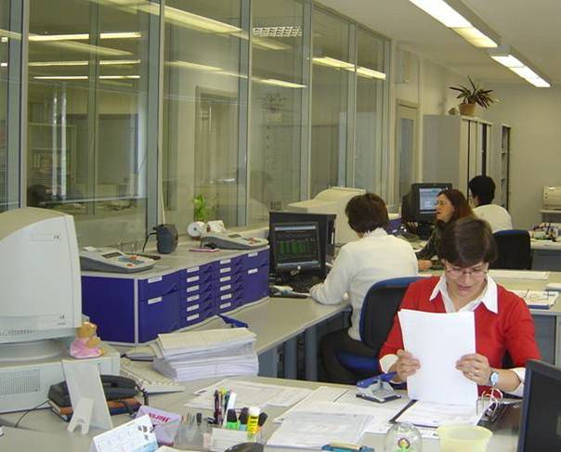
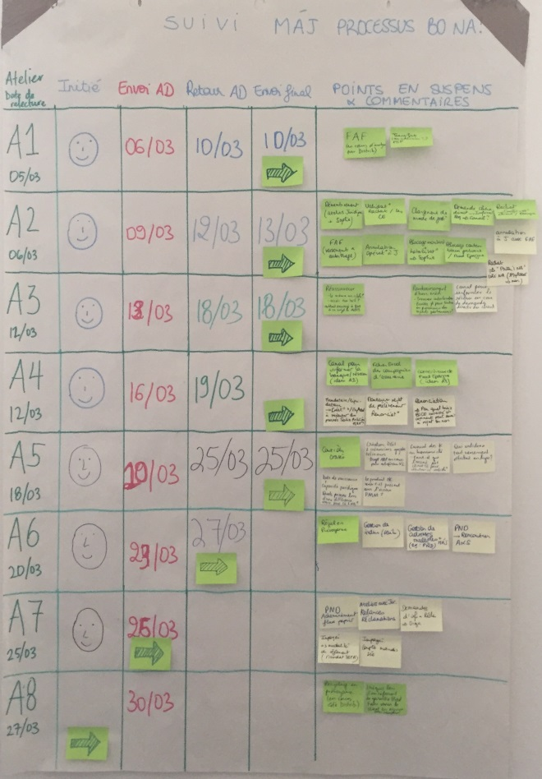
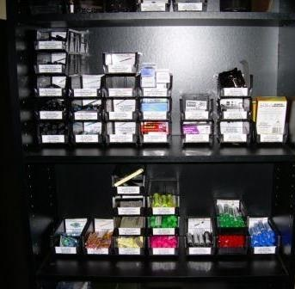
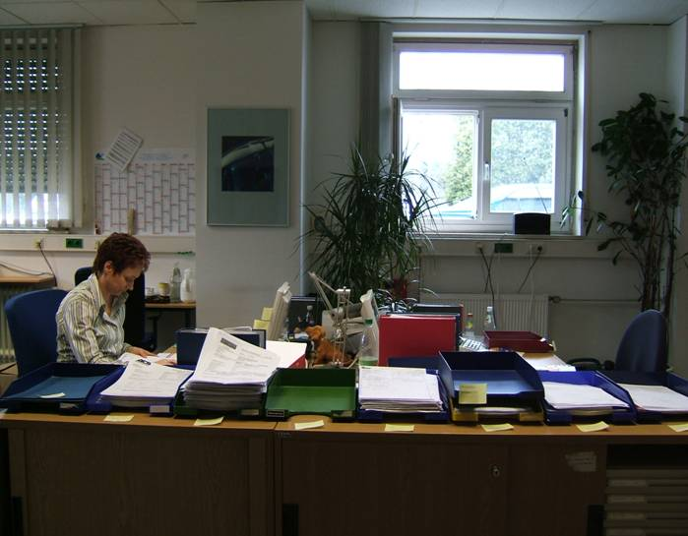
Examples of visual management
File cupboard
From hidden to making
the work visible :
Progress board : to share with the team the progress to date and the actions to complete
Stationery cupboard

Slide 46
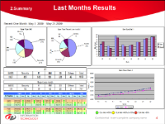
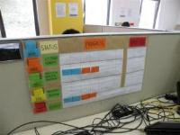
Lean management tools & techniques Visual Management - KPI & Metrics
Visual management shows KPIs that inform you of the CURRENT STATUS enabling you to make a controlled change.
Can your resources react to a change in customer demand?
Reviewing the past:
Last months productivity
Last years errors
Improving the future:
Reacting to current progress
Addressing today's issues
Limited scope to improve
Enable continuous improvement
Visual Displays allow us to highlight the gap between actual and expected performance and can act as the kick-off to improvement projects
Notes:
Use the car analogy:
If we drove like we typically do at work we would use our mirrors to guide us (Looking back)
We actually drive using windows, mirrors and dashboard and correct using steering, accelerator and breaks.

Slide 47
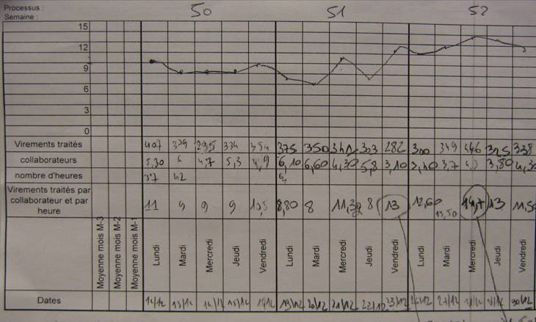
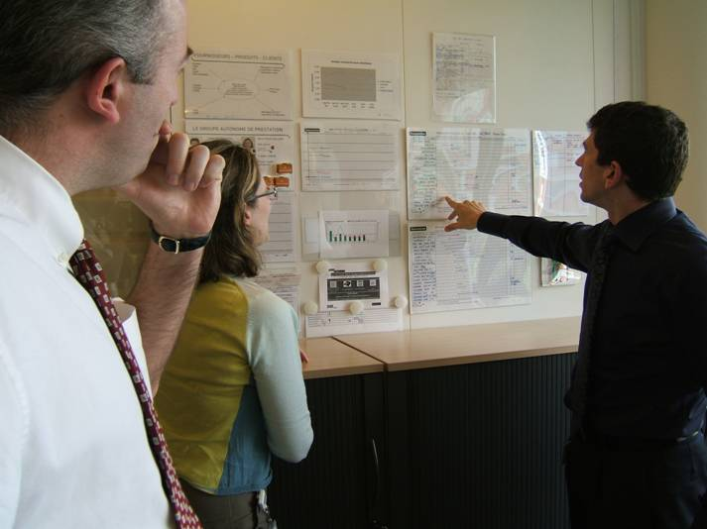
Lean management tools & techniques Daily routine to review performance on the visual management board…
Develop and track process KPI
Simple, key metrics that drive goals and management of the organization
Each KPI has a baseline and a target (including stretch goal)
Daily team meeting
Daily 15min morning discussion to review the KPI of the area
Identification of any new issues, review of the root causes and the action plan

Slide 48
Lean management tools & techniques … and to capture the daily issues (variance from the standard)
Problem | Cause(s) | Contremeasure(s)
Establish clearly the nature of the problem | Identify the potential root causes of the problem | Agree short term and mid term actions to mitigate identified root causes
Open questions | Ishikawa diagram and 5 Whys
What is the REAL problem:
Material
Machines or
systems
Who ?
What ?
Where ?
When ?
How ?
How many ?
Why ?
Problem
(Effect)
Item
Mother
Nature
Methods
Men
Use the 5 whys? to dive to the root causes
Establish a plan of action to validate the cause, eradicate the issue and update the new standard

Slide 49
Lean management tools & techniques Visual Management – the power of visual management is often neglected
In a visual workplace, the goal is to create an environment that is “self-explaining, self-ordering, and self-improving.”
Information is shared, to enable rapid understanding of:
Current operational performance
What the core process is
Performance against plan
Problems and what is being done to address them
Shows the ‘eye of the customer’
Facilitates team communication and should be the focal point of team meetings
Helps underpin a CI journey and empower employees to deliver improvement
Builds ownership and understanding of the inputs
Focuses people on collecting relevant data
Operations Hub
Quality cost and delivery measures (KPIs)
Standard operations
Ideas Board
Relevant performance metrics
5S update
People information
Standard daily huddle update
Cascades information
Escalates issues and drives actions

Slide 50
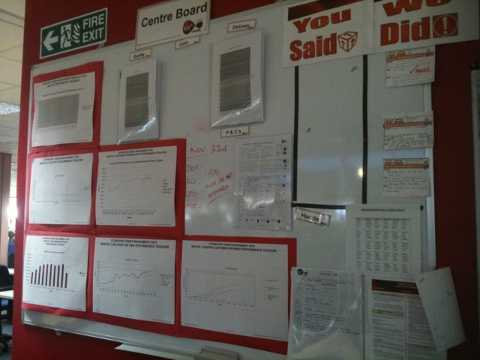
Lean management tools & techniques Visual Management provides a foundation for building a lean environment
Example layout
Performance Measures
Quality, cost and delivery measures
Displayed in trend format
Process Documentation
Process information
Standard operations
CI ideas board
CI Ideas board showing progress
and status
Supporting MI
5s status
Corrective actions
5s performance tracking
Daily huddle agenda
Standard daily update agenda
Completed for reference
People information
Skills matrix

Slide 51
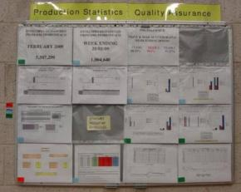
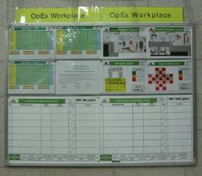
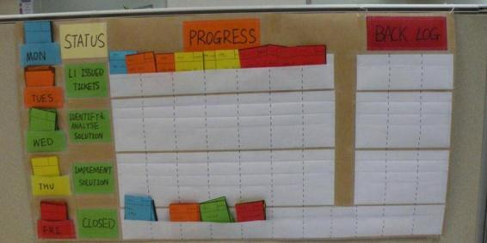
Example Visual Management Displays
Display boards created at a client site:
Process Output Statistics updated on a daily based
Statistics plotted as monthly trends
Display boards created at a Dalian:
Pilot Individual Ticket Progress Board to track the minute by minute progress of tickets raised each day as it progresses through the process.

Slide 52

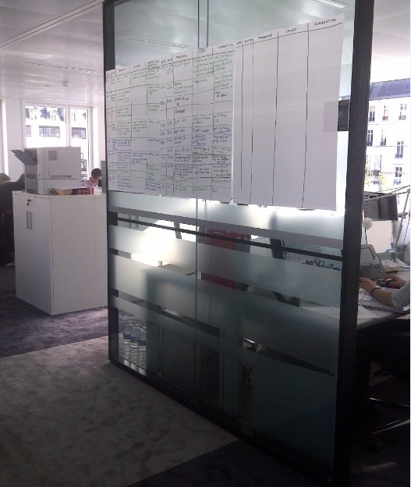
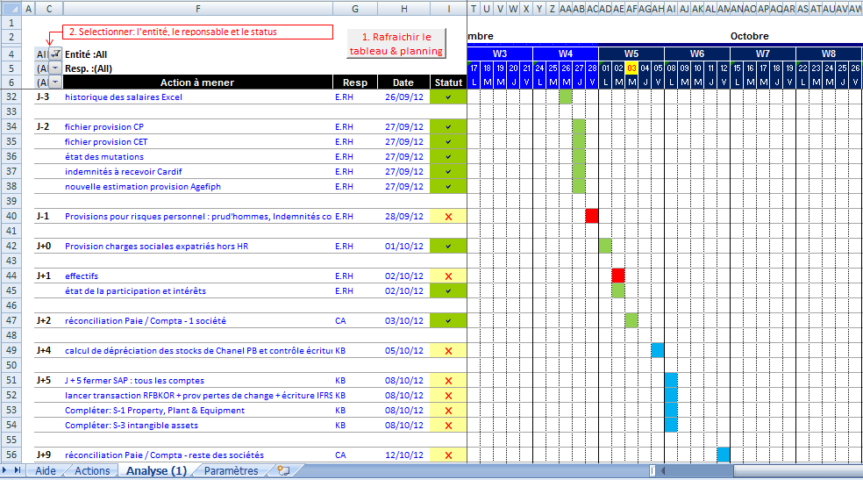

Example
Managing the year end financial closure process
Issue highlighted
Proposed solution
The tracking of progress was not formalised nor transparent
Not sure what info was still outstanding
No easy way to track the resolution of issues
Build a detailed planning per entity starting from the preparation phase
Monitor the end to end process (for all entities) with a visual display of what information /task are late and an escalation of key issues
Capture and act on issues
Built in Andon

Slide 53


Lean management tools & techniques Formalising the skills matrix
Example of skills matrix
Skill Matrix to be displayed in the working area
The Skill Matrix is a one page visual document to capture the skillset required for each role and the level of skills acquired by each team member.
It is a living tool necessarily updated and checked everyday.
Magic squares to be written on the matrix for each skills for each individual
Audit sheet
The magic square has 4 sides, completed as the person gains increasing expertise in the job:
I = Currently learning the task / skill
L = Knows and applies all job instructions with correct level of quality
U = Additionally ensures the quantity demanded
□ = Capable of training fellow team member.

Slide 54




Lean management tools & techniques An exercise in using SOPs
Notes:
The Tutor confirms that everybody knows what a fish is. The Tutor doesn’t draw a fish!!!!!
The tutor asks the participants to draw a fish.
The delegates compare their fish.
There will be variation in size, detail and direction.
The tutor explains this is not the fish that the customer was expecting.
Tutor draws parallels between real life and this exercise:
the delegates have interpreted the customers expectations rather than clarified them
Sizes and shapes are all different – is reflected to the different outputs that any process can deliver

Slide 55
Lean management tools & techniques Pre requisites for Standard Work
KNOWLEDGE OF THE TOPIC |  | KNOWLEDGE OF THE TOOLS |  | KNOWLEDGE OF THE BEST WAY TO PERFORM
Understanding of : - Policies - Regulations - Interpretation of the Law |  | Understanding of how to operate specific tasks using the new tools and systems available |  | Understanding of what is the most efficient sequence of tasks to perform each activity
FOUNDATIONS |  | OPERATIONAL SKILLS |  | SOP
Training is required to acquire the relevant competencies to perform specific roles
End to end processes
Teaching
Learning
Guidance
Standard
Operating
Procedure
Performing
Experiencing

Slide 56
Lean management tools & techniques Standard Work
Standard Work means that everyone performs their work in the same way, and that is currently the best way we know how to do it
Standard Work is the foundation of Lean and is the essential base for continuous improvement
Standard Work is a method of defining, organizing and agreeing the activity in a process so as to ensure:
The most effective & efficient use of resources, people, tools and equipment
That the customer receives a consistently high level of quality in every product or service
It requires the engagement of people at every level, with everyone focusing on the needs of the customer.
Continuous improvements
Without standardization, all improvements will roll back in time
“Without Standard Work there can be no Continuous Improvement”

Slide 57
Lean management tools & techniques Standard Work – Practical use
Steps to develop an SOP:
Brainstorm with the team to identify all the steps required to carry out a task or activity. Include individuals outside the team who are expected to carry out the task after the project is completed; this helps with buy-in later
Organize activities into the proper time sequence and confirm with the team
Write the SOP to include additional requirements that need to be explained to ensure a uniform output every time. (e.g. Key points to be aware of)
Review the draft SOP with the team by repeated trialling of it. Confirm that the process output delivers consistent required quality
Approve the SOP and train all operators
Audit the application of the SOP
Brainstorm
Organize
Write
Review
Approve
Audit
All employees at all levels are actively encouraged and expected to regularly improve procedures

Slide 58


Example Standard Work in Lean service environment
Standard operating procedure
Decision tree
Key steps to follow in sequence
Key important points to be aware of:
Symbol | Legend | Description
 | Tip | A tip is a note or a practical advice for the operator to be aware of.
 | Caution | A very important message to focus the attention of the operator on: - Action(s) that have to be performed - Consequence(s) of not doing the action
 | Check | A point in the process where the operator would need to examine the accuracy, quality, or condition of the task being performed
⬇ | Specific | An action to be performed at this stage that refer to a very specific entry or form being processed.

Slide 59
Example Standard Work in Lean manufacturing
Cycle Time Diagram
Standardised Operating Procedure
Takt time
Standardised Work in manufacturing is documented with:
1) Standard Operation Procedure
2) Standardized Work Chart
3) Work Combination Table
and is audited regularly to ensure compliance
Time
1
2
3
4
5
A
B
C
D
Work Stations
Standardised Work Chart
Standardised Work Combination Table
All process steps are repre-sented in line with the SOP
Sum of the Work Content is within the Takt Time

Slide 60

Lean management tools & techniques Standard Work key points
Hot Tips
SOP = clear set of Instructions to enable Standard Work.
Increased efficiency for repeating the process.
SOP = visual picture of the workflow
Developing an SOP is not trivial (allocate resources)
Make sure the right people are involved in developing the SOP (ownership).
It takes many iterations to get it right
It’s a ’living document’
If performance is below customer expectation you need to re-visit the SOP
Change it when efficiency can be improved.
Document actions if something goes wrong (outside the standard).
Changing the big WHAT’s requires Technical Authorisation, however changing the small how’s is within the authority of the team.
On boarding of new staff (“big crew change”)
Capture corporate knowledge

Slide 61


Transferring activities to BAU Without this there is risk the changes and benefits may not be realised
People development
Sustainability
Visual Management
Select the right people
Define roles & responsibilities
Training on new process
Daily team reviews
Weekly reporting
Capture issues & improvement actions
Root cause analysis board
Management reviews
Test cell mission
Ways of working
Team members
Live skill matrix
Live performance measures
Tips & learning points
Documentation
Process map
Critical contact blue print
Standardised Operating Procedures
Decision trees
Daily & Weekly tasks
KPI definition & reporting mechanism
All best practices harvested during the Work Pilot need to be captured onto the operations knowledge base
Plan the transfer of the new process to BAU
Solution implementation plan established, including schedule/work breakdown structure, resources, risk management plan, cost/budget, and control plan
Contingency plan established

Slide 62

Set up and “improvement forum” to sustain
continuous improvement actions into BAU Create an on-going way for the business to maintain improvements

Slide 63
Agenda Day 4 – Future State 2 & Work Pilot
Section 1 | Teach Back – Days 1, 2, and 3 Introduction to Future State 2
Section 2 | Action Brainstorm Work Breakdown Structure Work Packages Exercise - Implementing the Future State Design
Section 3 | Introduction to Work Pilot Set Up & Run a Work Pilot
Section 4 | Run Final Simulation Record and review simulation performance
Section 5 | Lean management tools and techniques Planning the Transfer to BAU
Section 6 | Course Review & Wrap up Overall WWW and WBBI

Slide 64
Day 4 Review and Wrap Up
We have:
Identified and Prioritised Work Packages
Created Charters and a High Level Plan
Run the simulation for the final time
Set Up and Run the Work Pilot
FS2
W
✓
✓
✓
✓
✓
✓
M
CS1
CS2
FS1
FS2
W

Slide 65
La communauté
Rejoignez nous !

Slide 66
Lean Six Sigma en action
Montée en compétence des équipes
Master
Black Belt
Le Master Black Belt a réalisé et supervisé plusieurs projets ou programmes de LEAN. Véritable "mentor" pour les Black Belt, il les forme et les assiste dans les domaines du Lean, du Six Sigma et des outils associés.
Black Belt
Le Black Belt : chef d'équipe qui se consacre à l'amélioration de processus (à travers notamment des programmes d’excellence opérationnelle), à la conduite de projets et à la formation des Green Belts. Il maîtrise la méthode dans son ensemble.
Il a déjà conduit plusieurs projets/programmes Lean Six Sigma (2000 h) et 5M€ de gain.
Green Belt
Le Green Belt sait mettre en œuvre la méthodologie LEAN et peut seconder les Black Belt dans la réalisation de projet d’amélioration de processus.
Il a déjà réalisé un projet Lean (500 h) et 1M€ de gain.
Yellow Belt
Le Yellow Belt accompagne les projets d’amélioration de processus. Il comprend la méthodologie et est capable de suivre les projets.

Slide 67
La communauté LSS Deloitte
Nos objectifs
Pour nos Collaborateurs
Contribuer à leur développement personnel en les aidant à acquérir des compétences complémentaires communes dans les domaines de la résolution de problème, de l’amélioration continue et de la conduite du changement
Contribuer à une initiative transverse Deloitte France et d'élargir leur réseau au sein de la firme
Faciliter la recherche d’information pour la rédaction de propositions commerciales
Mettre en valeur auprès de leur CR et associés leurs contributions tant sur le plan du développement commercial (porter l'offre Lean) que sur le plan marketing (Eminence)
Pour Deloitte France et global
Consolider et développer de nouvelles offres dans l’excellence opérationnelle
Fédérer les compétences internes d'amélioration de la performance
Établir un relais avec les initiatives LSS européennes ou globales pour pouvoir répondre aux enjeux de clients multinationaux
Pour nos Clients
Répondre à des enjeux et problématiques métiers d'amélioration de la qualité et du service client, d'efficacité opérationnelle, d'engagement des employés et de réduction de couts
Etablir ou redynamiser leurs programmes d'excellence opérationnelle ou d'amélioration continue
Bénéficier de points de vue novateurs et innovants dans l’excellence opérationnelle

Slide 68









La communauté LSS Deloitte
Organisation et contacts
Animation
Faire vivre et grandir la communauté
Célia El Bayed
Panya Viraphan
Formation
Partager des approches et un langage communs
Etienne Pailler
Béatrice Barriol
Offre
Répondre aux problématiques de nos clients
Camille Bidegaray
Carine Letor
Béatrice Barriol
Eminence
Développer des points de vue novateurs et innovants
Xavier Muller
Wissem Hechi
KM &
Sales
Partager et faciliter la recherche d’information
Xavier Muller
Ghizlane Safi

Slide 69

La communauté LSS Deloitte
Pour participer !
Canal de communication
Contenu
Fréquence
Groupe Yammer
Groupe Yammer permettant de partager la méthodologie LSS, des articles, ainsi que les actualités de la communauté.
Continue
Ayant lieu une fois par mois, ce call et rendez-vous rassemble l’ensemble des membres de la communauté afin de leur apporter de la visibilité sur les initiatives en cours et à venir.
Rendez-vous mensuel
Mensuelle
Communication interne Deloitte sur les actualités de la communauté, les succès et temps forts, les prochains évènements ainsi que quelques publications sur le Lean Six Sigma.
Newsletter
Trimestrielle
Evènement
Partage de façon informelle entre tous les membres de la communauté sur les actualités ou tout autre sujet.
Ponctuelle

Slide 70

Final Thoughts and Q&A Session Ask away...

Slide 71

WWW & WBBI Your thoughts
What Worked Well?
Would Be Better If?

Slide 72
This is an internal document which provides confidential advice and guidance to partners and staff of Deloitte MCS Limited. It is not to be copied or made available to any other party.
© 2015 Deloitte MCS Limited. All rights reserved.
Member of Deloitte Touche Tohmatsu Limited

